Slide 1
Smartphone Screen Orientation
Barrett Honors Thesis
Riley Tallman

Slide 2
Introduction My background
Graduating this semester with undergrad, then 4+1
CSE 471 Intro to AI (Prof Gil)
CSE 494 AI In Cyber Security
CSE 494 Machine Learning
CSE 571 Artificial Intelligence
CSE 494 Intro to Robotics
Computer Vision
Self Driving Cars

Slide 3
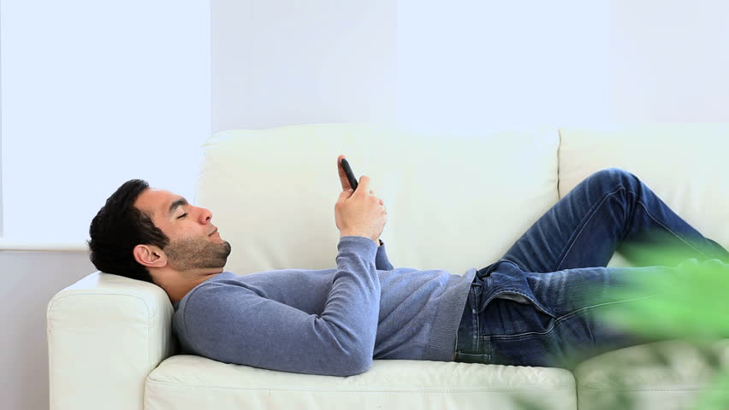
Introduction The Problem

Slide 4
Solution 1 Pre-trained Models

Slide 5
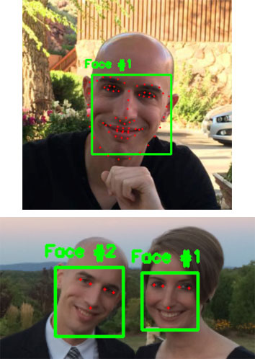


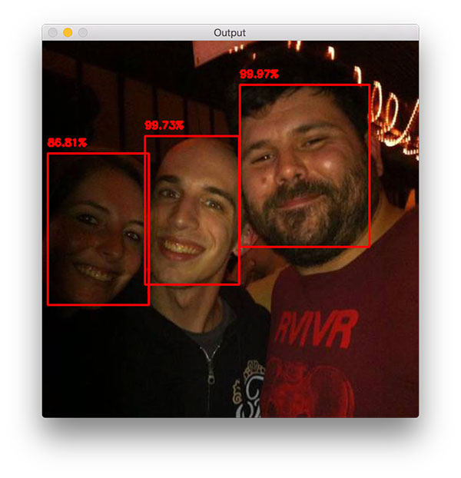
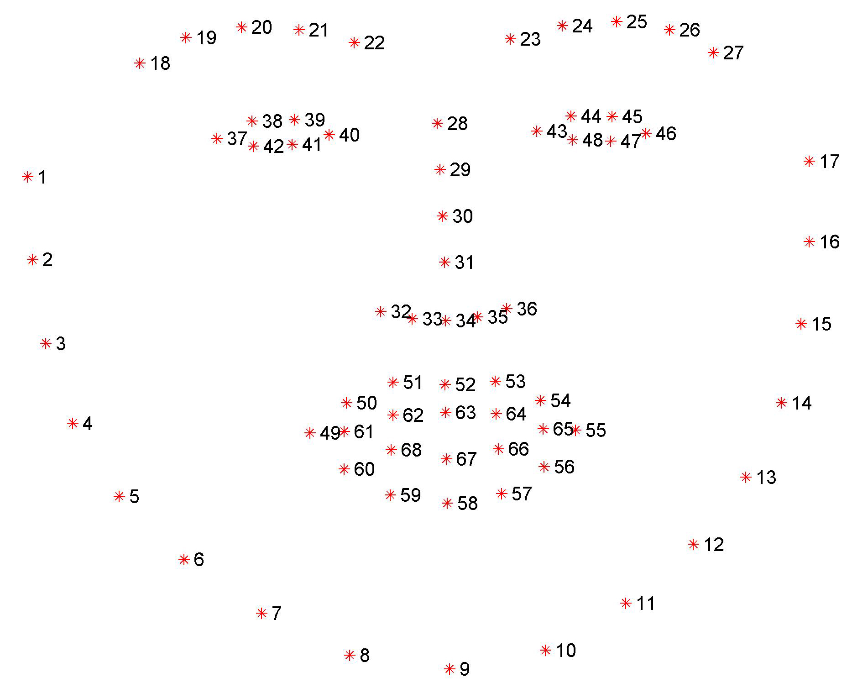
Solution 1 Pre-trained Models
Orientation!
dlib 68/5-point landmark detector
https://www.pyimagesearch.com/2017/05/22/face-alignment-with-opencv-and-python/

Slide 6
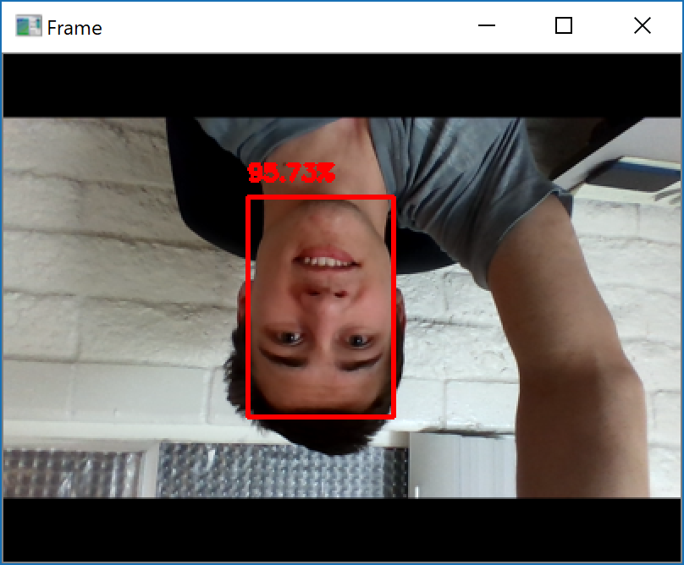
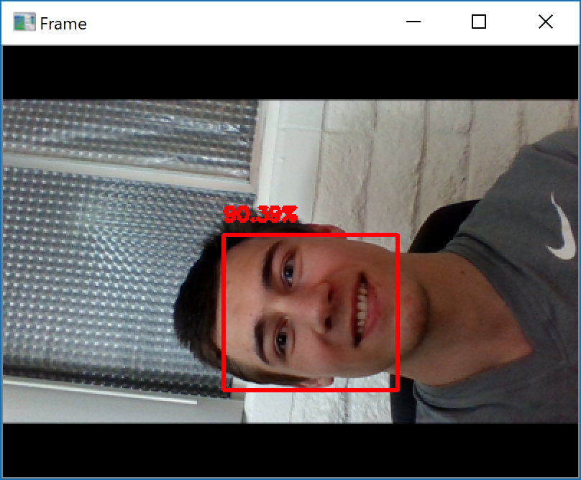
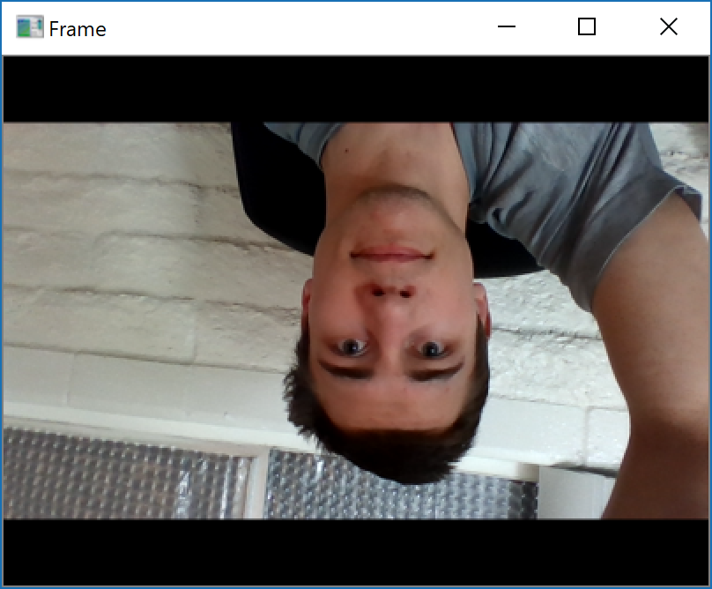
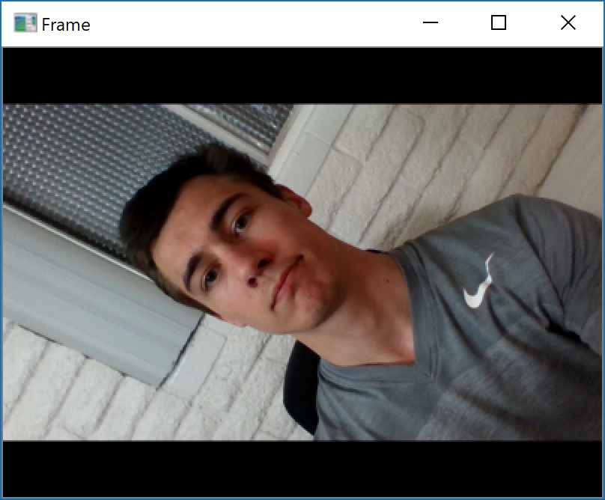
Solution 1 Pre-trained Models
OpenCV
dlib
https://www.pyimagesearch.com/2017/05/22/face-alignment-with-opencv-and-python/

Slide 7

Solution 1 Pre-trained Models
dlib 5-point landmark detector
Orientation!
OpenCV
https://www.pyimagesearch.com/2017/05/22/face-alignment-with-opencv-and-python/

Slide 8
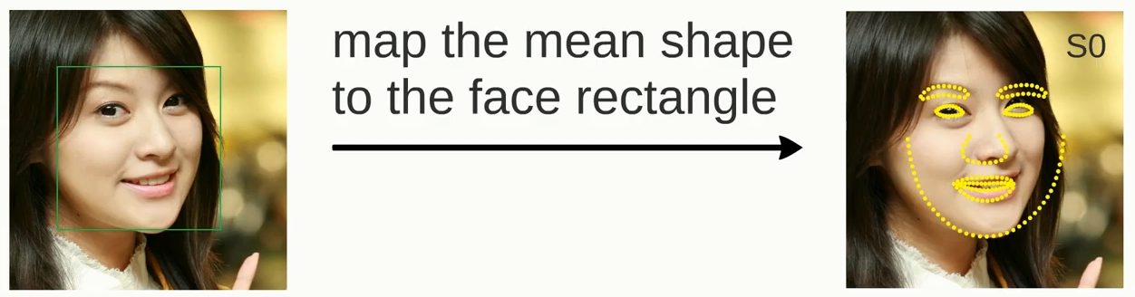
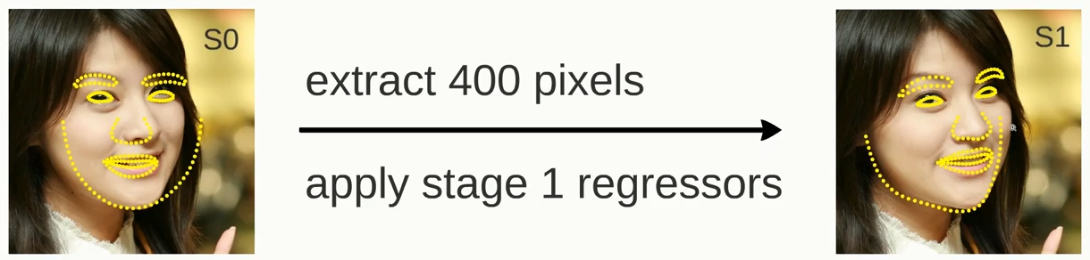
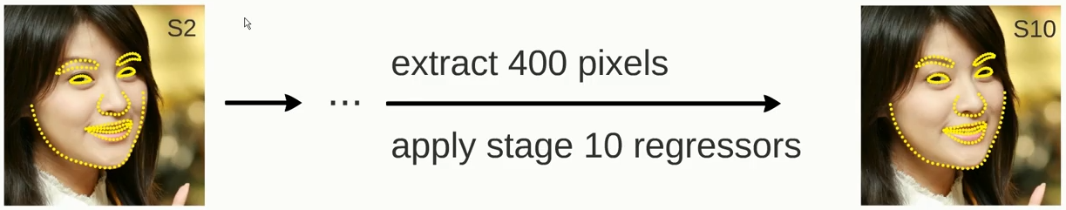
Solution 1 Pre-trained Models – Failure
https://www.youtube.com/watch?v=SLLZr9IjPcE

Slide 9
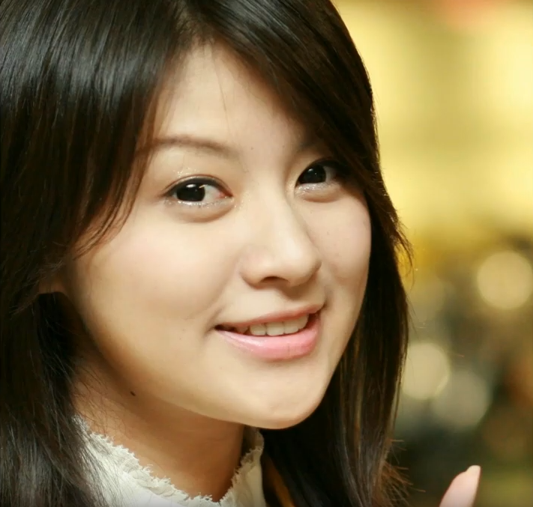

Solution 1 Pre-trained Models – Failure

Slide 10
Solution 2 Pre-trained Models Without 68/5 point

Slide 11
Solution 2 Hack the system
?
?
?

Slide 12


Solution 2 How it works
Rotations
Vertical-only face detector
Input Image from camera
Orientation!

Slide 13
Solution 2 Faced Results
https://towardsdatascience.com/faced-cpu-real-time-face-detection-using-deep-learning-1488681c1602

Slide 14
Solution 3 DIY – design my own😁

Slide 15
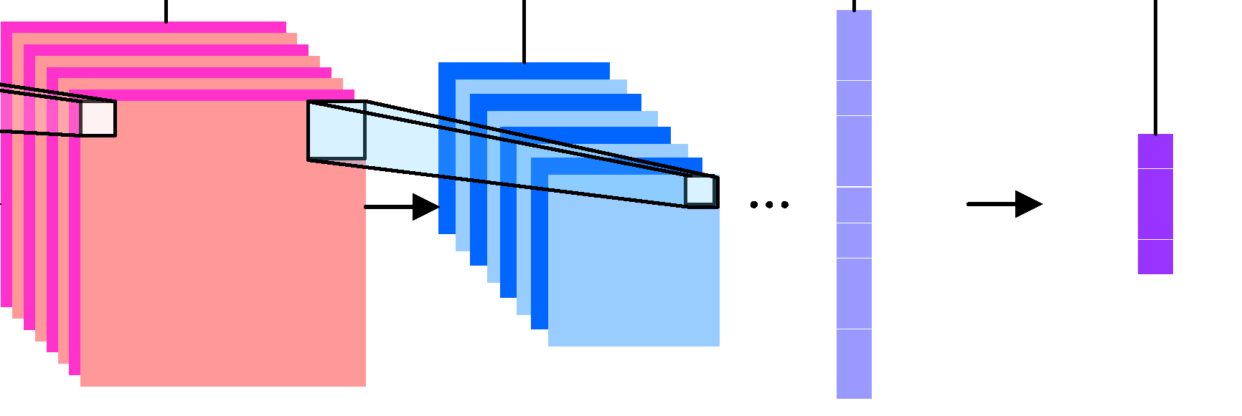
Solution 3 DIY
4-Class Classification, simple!
Input Image from camera
Orientation!

Slide 16
Solution 3 DIY
Helen dataset – looks like selfies
Total params: 104,996
VGG style:
Conv – Conv – Pool - Dropout
Conv – Conv – Pool – Dropout
Conv – Conv – Pool – Dropout
Dense(256)

Slide 17
Solution 3 Next Steps
Test interpolation techniques
Random Image augmentation
Rotations
lighting
Tune Hyperparameters

Slide 18
Speed What is fastest

Slide 19
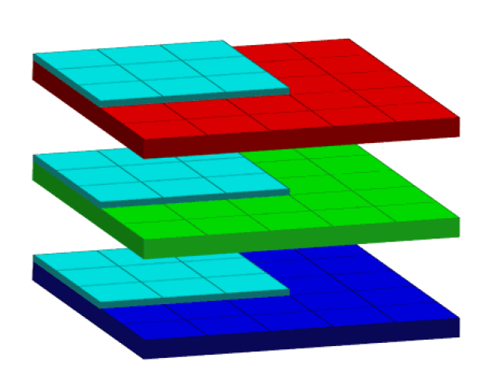
Smartphone Performance What effects performance?
Model Size?
Frames per second?
Grayscale vs. RGB?
iPhone 6, iPhone XS to test with
Xcode – swift
Working camera application
Battery life!
How much battery does the current solution use?

Slide 20
Questions? Suggestions for me? Thanks

